Slide 1
18ECC204J DIGITAL SIGNAL PROCESSING – WEEK 1

Slide 2
Syllabus Overview
Learning Unit / Module 1: Signals and Waveforms
Learning Unit / Module 2: Frequency Transformations
Learning Unit / Module 3: FIR Filters
Learning Unit / Module 4: IIR Filters
Learning Unit / Module 5: Multirate signal Processing

Slide 3
Lab Experiments
Lab 1.a) Generation of basic signals
b) Unit step, ramp and impulse
Lab 2: Continuous and discrete time
Lab 3: a) Study of sampling theorem
b) Aliasing effects
Lab 4: a) Linear convolution
b) Circular convolution
Lab 5: a) Autocorrelation and cross correlation
b) Spectrum analysis using DFT
Lab 6: a) Efficient computation of DFT using FFT
b) Computation of IDFT
Lab7: a) Design of digital FIR Low Pass and High Pass filter using rectangular window
b) Design of digital FIR Band Pass and Band Stop filter using rectangular window

Slide 4
Lab8: a) Design of digital FIR Low Pass and High Pass filter using Hanning and Hamming window
b) Design of digital FIR Band Pass and Band Stop filter using Hanning and Hamming window
Lab 9: Design of digital FIR filter using frequency sampling method
Lab10: a) Design of analog Butterworth filter
b) Design of analog Chebyshev filter
Lab 11: a) Design of digital Butterworth filter using impulse invariance method
b) Design of digital Butterworth filter using bilinear transformation
Lab12: a) Design of digital Chebyshev filter using impulse invariance method
b) Design of digital Chebyshev filter using bilinear transformation
Lab 13: a) Interpolation
b) Effect of interpolation in frequency domain
Lab 14: a) Decimation
b) Effect of decimation in frequency domain
Lab 15: a) Design of anti-aliasing filter
b) Design of anti-imaging filter

Slide 5
Learning Unit / Module 1: Signals and Waveforms
Basic Elements of DSP , Advantages and applications of DSP
Continuous Time vs Discrete time signals , Continuous valued vs discrete valued signals.
Concepts of frequency in analog signals , Continuous and discrete time sinusoidal signals ,
Sampling of analog signals Sampling theorem
Aliasing Quantization of continuous amplitude signals,
Analog to digital conversion Sample and hold, Quantization and coding
Oversampling A/D converters , Digital to analog conversion Sample and hold
Oversampling D/A converters, Quantization noise
Errors due to truncation IDFT, Probability of error

Slide 6
Data Vs Signal
Data – information formatted in human/machine readable form
• examples: voice, music, image, file
Signal – electric or electromagnetic representation of data
• transmission media work by conducting energy along a physical path; thus, to be transmitted, data must be turned into energy in the form of electro-magnetic signals
Transmission – communication of data through propagation and processing of signals

Slide 7
What is a Signal?
A signal is a pattern of variation of some form
Signals are variables that carry information
Examples of signal include:
Electrical signals
Voltages and currents in a circuit
Acoustic signals
Acoustic pressure (sound) over time
Mechanical signals
Velocity of a car over time
Video signals
Intensity level of a pixel (camera, video) over time

Slide 8
How is a Signal Represented?
Mathematically, signals are represented as a function of one or more independent variables.
Example : signals that are a function of a single variable: time
f(t)
t

Slide 9
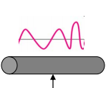
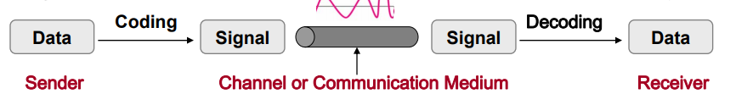
Data Transmission System

Slide 10
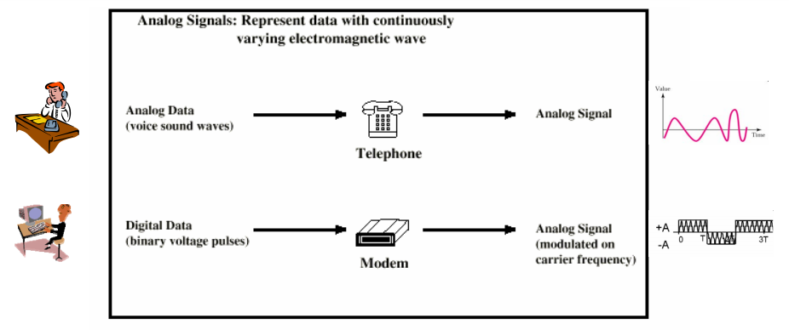
Example : Analog Signal vs Digital Signal

Slide 11
What is Digital Signal Processing?
DSP
Process of representing signals in a discrete mathematical sequence of numbers and analyzing, modifying, and extracting the information contained in the signal by carrying out algorithmic operations and processing on the signal.

Slide 12
What is a Digital Signal Processing System?
Digital: Operating by the use of discrete signals to represent data in the form of numbers.
Signal: A signal is anything that carries some information. It’s a physical quantity that conveys data and varies with time, space, or any other independent variable. It can be in the time/frequency domain. It can be one-dimensional or two-dimensional.
Processing: The performing of operations on any data in accordance with some protocol or instruction is known as processing.
System: A system is a physical entity that is responsible for the processing. It has the necessary hardware to perform the required arithmetic or logical operations on a signal.
Putting all these together, we can get a definition for DSP.

Slide 13
DSP Applications
Audio signal processing
Audio compression
Digital image processing
Video compression
Speech processing, speech recognition
Digital communications, digital synthesizers, radar, sonar, financial signal processing, seismology and biomedicine.
Specific examples include speech coding and transmission in digital mobile phones, weather forecasting, economic forecasting, seismic data processing, analysis and control of industrial processes, medical imaging such as CAT scans and MRI, MP3 compression, computer graphics, image manipulation, audio crossovers and equalization, and audio effects units.

Slide 14
DSP Applications- Example
Telecommunication
For echo cancellation.
Equalization – Think about tuning your radio for bass and treble).
Filtering – Removing unwanted signals using specially designed filters like the Infinite Impulse Response Filter (IIR).
Multiplexing and repeating signals.
Instrumentation and Control
In designing Phase Locked Logic (PLL).
Noise reduction circuits.
Compression of signals, Function generators.
Digital Image Processing
Compression of an image- Enhancement, reconstruction, and restoration of an image.
Analysis or face detection (like Snapchat).
Speech Processing
Digital audio synthesis.
Speech recognition and analysis.
Medicine
X-rays, ECGs, EEGs.
Signal filtering
Noise removal and shaping of signal spectrums.
Military
Sonar and navigation.
Analysis after tracking in radars.
Consumer electronics
Music players
Professional music turntables

Slide 15
Basic Elements of Digital Signal Processing System
Both the input signal and the output signal are in analog form.
Digital signal processing provides an alternative method for processing the analog signal.
To perform the processing digitally, there is a need for an interface between the analog signal and the digital processor.

Slide 16
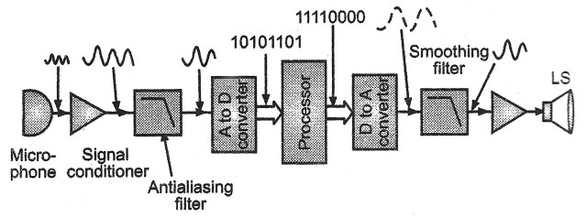
Block Diagram of DSP

Slide 17
DSP System – Operation
The first step is to get an electrical signal. The transducer (in this case, a microphone) converts sound into an electrical signal.
Once you have an analog electrical signal, we pass it through an operational amplifier (Op-Amp) to condition the analog signal.
The anti-aliasing filter is an essential step in the conversion of analog to a digital signal. It is a low-pass filter. Meaning, it allows frequencies up to a certain threshold to pass. It attenuates all frequencies above this threshold. These unwanted frequencies make it difficult to sample an analog signal.
The next stage is a simple analog-to-digital converter (ADC). This unit takes in analog signals and outputs a stream of binary digits.
The heart of the system is the digital signal processor. These days we use CMOS chips (even ULSI) to make digital signal processors. In fact, modern processors, like the Cortex M4 have DSP units built inside the SoC. These processor units have high-speed, high data throughputs, and dedicated instruction sets.

Slide 18
DSP System – Operation (Cont’d)
The next stages are sort of the opposite of the stages preceding the digital signal processor.
The digital-to-analog converter does what its name implies. It’s necessary for the slew rate of the DAC to match the acquisition rate of the ADC.
The smoothing filter is another low-pass filter that smoothes the output by removing unwanted high-frequency components.
The last op-amp is just an amplifier.
The output transducer is a speaker in our case. You can use anything else according to your requirements.

Slide 19
DSP System – Operation (Cont’d)
The study of the digital representation of signals is known as digital signal processing.
It converts all the real world signals into digital form with the aid of an Analog to Digital Converter.
On completion of the processing, the digital signal is converted back to Analog form using Digital to Analog Converter.

Slide 20
Advantages of DSP
High level of accuracy.
The filters designed in DSP have firm control over output accuracy as compared to analog filters.
Easy Upgradations, Implementation of algorithms
The reconfiguration in an analog system is very much tough because the entire hardware and its component will have to be changed. On the contrary, a DSP reconfiguration is much more comfortable as only the code, or the DSP program needs to be flashed after making the changes according to the requirements.
The interface types offered by DSP are many like UART, 12C, and others. This helps in interfacing other ICs with the DSP.

Slide 21
Advantages of DSP (Cont’d)
The combination of DSP interfaced with FPGA helps in designing the protocol stack of the whole wireless system like WiMAX, LTE, etc. In this type of architecture, as per the latency requirements, few of the modules are ported on FPGA and the other few on DSP.
Implementation in digital is much more cost effective than its analog counterpart.
Repeatability
The digital system in DSP can be easily cascaded without any problems in loading.
Digital circuits can be easily reproduced in huge quantities cost effectively.
Accessible transportation is possible because digital signals can be processed offline.

Slide 22
Advantages of DSP system (Cont’d)
A digital signal processing system enjoys many benefits over an analog signal processing system. Some of these advantages are briefly outlined below:
Less overall noise
Since the signals are digital and inherently possess a low probability of getting mixed with unwanted signals, the entire system benefits. Thus, DSPs don’t really have as much noise to deal with comparatively.
Error detection and correction is possible in DSPs
Again, the presence of digital signal means we have access to many error detection and correction features. For example, we can use parity generation and correction as a detection and correction tool.
Data storage is easier
Yet again, an advantage because of digital signals. You know how easy it is to store digital data, right? We can choose from a wide plethora of digital memories. However, analog data needs to be stored in tapes and stuff like that. It’s harder to transport and recreate with 100% fidelity.
Encryption
Digital signals are easy to encrypt. So this one counts as a win for the entire DSP system too.
Easier to process
Digital signals can easily undergo mathematical changes as compared to their analog counterparts.

Slide 23
Advantages of DSP system (Cont’d)
More data transmission
Time-division multiplexing is a great tool available for digital systems to transmit more data over unit time and over a single communication path.
Higher component tolerance in DSP
The components like resistors, capacitors, and inductors have a certain threshold in terms of temperature. Outside this threshold, as the temperature increases, they might start behaving erratically.
These components are not present in a digital system. Moreover, digital systems can increase their accuracy with concepts like floating-point arithmetic.
Easier to modify
To modify an analog processing system, you need to change components, test, and verify the changes. With digital processing systems, you just need to change a few commands or alter a few lines of code.
DSP systems can work on frequencies of a broader range
There are some natural frequencies, like seismic frequencies that detect earthquakes. These signals have very low frequencies. Traditional analog signals might not even detect these signals. However, digital signal processing systems are adept at picking up even the tiniest of disturbances and also process them easily.
Cost
When working at scale, DSPs are cheaper.

Slide 24
Disadvantages of a DSP(Cont’d)
When using DSP, there is a need for using anti-aliasing filter before ADC as well as using a reconstruction filter after DAC . Due to the use of this extra two modules viz. ADC and DAC, the complexity of DSP based hardware increases.
DSP processes the signal at high speed and comprises of more top internal hardware resources. Because of this DSP dissipates higher power as compared to analog signal processing. Analog signal processing includes passive components that consume lower energy.
Each DSP has a different hardware architecture and software instructions. Due to this, only highly skilled engineers can program the device. Proper training on DSP is required for programming for various applications.

Slide 25
Disadvantages of a DSP(Cont’d)
One needs to cautiously use the IC as per hardware and software requirements as most of the DSP chip is very expensive.
Only in a synchronized communication system, the detection of digital signals is possible but it not so in the case of analog systems.
Higher bandwidth is required for digital communication than analog for transmission of the same information.

Slide 26
Disadvantages of a DSP (Cont’d)
Complexity
As we saw in the block diagram above, there are a lot of elements preceding and following a Digital Signal Processor. Stuff like filters and converters add to the complexity of a system.
Power
A digital signal processor is made up of transistors. Transistors consume more power since they are active components. A typical digital signal processor may contain millions of transistors. This increases the power that the system consumes.
Learning curve and design time
Learning the ins and outs of Digital Signal processing involves a steep learning curve. Setting up digital processing systems thus takes time. And if not pre-equipped with the right knowledge and tools, teams can spend a lot of time in setting up.
Loss of information
Quantization of data that is below certain Hz causes a loss in data according to the Rate-Distortion Theory.
Cost
For small systems, DSP is an expensive endeavor. Costing more than necessary.

Slide 27
Continuous Time signals:
A signal of continuous amplitude is called continuous signal or analog signal. Continuous signal has some value at every instant of time.

Slide 28
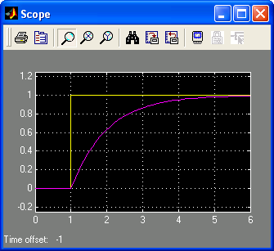
Example: Signals in an Electrical Circuit
R
v_{s}
+
-
i
C
v_{c}
The signals v_{c} and v_{s} are patterns of variation over time
Note, we could also have considered the voltage across the resistor or the current as signals
Step (signal) v_{s} at t=1
RC = 1
First order (exponential) response for v_{c}
v_{s}, v_{c}
t

Slide 29
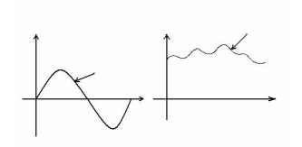
Continuous Time signals:
Examples:
Sine wave, cosine wave, triangular wave etc. similarly some electrical signals derived from physical quantities like temperature, pressure, sound etc. are also an examples of continuous signals.
Mathematical expression:
Mathematically a continuous signal can be expressed as,
x(t)=A sin(wt)
For every fix value of t, x(t) is periodic in nature.
If the frequency (1/t) is increased then the rate of oscillation also changes.

Slide 30
Discrete Time signals:
Discrete time signal:
In this case the value of signal is specified only at specific time. So signal represented at “discrete interval of time” is called as discrete time of signal.
The discrete time signal is generated from continuous time signal by using the sampling operation. This process is shown in figure below.

Slide 31
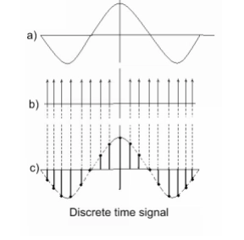
Example
Consider a continuous analog signal as shown in figure
a). This signal is continuous in nature from –infinity to +infinity.
The sampling pulses are shown in figure
b). These are train of pulses. Here the samples are taken with Ts as sampling time.
Figure c) shows the discrete time signal
For signal shown in figure a), the expression is x(t)=A cos (wt)
And for signal shown in fig c) , the expression is x(t)= A cos (wn)

Slide 32
Continuous & Discrete-Time Signals
Continuous-Time Signals
Most signals in the real world are continuous time, as the scale is infinitesimally fine.
Eg. voltage, velocity,
Denote by x(t), where the time interval may be bounded (finite) or infinite
Discrete-Time Signals
Some real world and many digital signals are discrete time, as they are sampled
E.g. pixels, daily stock price (anything that a digital computer processes)
Denote by x[n], where n is an integer value that varies discretely
Sampled continuous signal
x[n] =x(nk) – k is sample time
x(t)
t
x[n]
n

Slide 33
Continuous valued or discrete valued signals:
Continuous valued signals:
If the variation in the amplitude of signal is continuous then, it is called continuous valued signal. Such signals may be continuous or discrete in nature. Following figure shows the examples of continuous valued signals.
Discrete valued signals:
If the variation in the amplitude of signal is not continuous but the signal has certain discrete amplitude levels then such signal is called as discrete valued signal. Such signal may be again continuous or discrete in nature as shown in figure below.

Slide 34

Continuous-valued Signals
Continuous-valued Signals
If a signal takes on all possible values on a finite or an infinite range, it is said to be a continuous-valued signals
If a signal takes on values from a finite set of finite set of possible values, it is said to be a discrete-valued signals

Slide 35
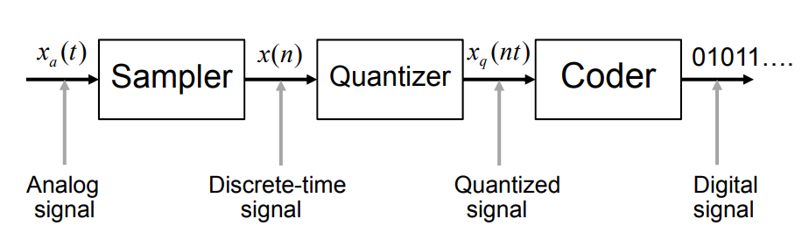
Basic Parts of Analog to Digital Convertor

Slide 36
What is a System?
Systems process input signals to produce output signals
Examples:
A circuit involving a capacitor can be viewed as a system that transforms the source voltage (signal) to the voltage (signal) across the capacitor
A CD player takes the signal on the CD and transforms it into a signal sent to the loud speaker
A communication system is generally composed of three sub-systems, the transmitter, the channel and the receiver. The channel typically attenuates and adds noise to the transmitted signal which must be processed by the receiver

Slide 37
How is a System Represented?
A system takes a signal as an input and transforms it into another signal
In a very broad sense, a system can be represented as the ratio of the output signal over the input signal
That way, when we “multiply” the system by the input signal, we get the output signal
This concept will be firmed up in the coming weeks
Input signal
x(t)
System
Output signal
y(t)

Slide 38
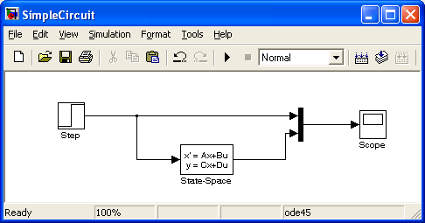
Example: An Electrical Circuit System
R
v_{s}
+
-
i
C
v_{c}
Simulink representation of the electrical circuit
v_{s}(t)
v_{c}(t)
v_{s}, v_{c}
first order
system
t

Slide 39
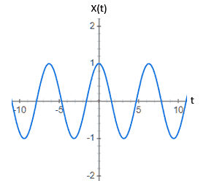
What is the difference between continuous-time and discrete-time signals?
A Continuous-Time Signal is defined for all values of time. X is the dependent variable and t is the independent variable. When there is an X(t) for every single value of t, it is continuous.
For example, sinusoidal graphs which have the time limit of infinity to negative infinity are clearly continuous-time signals.

Slide 40
Discrete Time signals
A common misconception is that discrete and digital signals are congruous but they are in fact very different.
For discrete-time signals, time is discrete while the amplitude is continuous.
However, for digital signals both the amplitude and time are discrete.

Slide 41
Review Questions
What is DSP?
What are the basic elements of DSP?
Give the main advantages of DSP over ASP
What is Anti-alising filter?
Give the disadvantages of DSP

Slide 42
Answers
DSP
Process of representing signals in a discrete mathematical sequence of numbers and analyzing, modifying, and extracting the information contained in the signal by carrying out algorithmic operations and processing on the signal.
Basic Elements of DSP
Input,Anti-alising factor,ADC,Processor, DAC, Output
Advantages of DSP
Accuracy
Repeatability
Ease of Upgradations
Implementation of Algorihtms
Cheaper
Less overall noise
Error detection and correction is possible in DSPs
Data storage is easier
Easier to process

Slide 43
Answers
Anti-alising Filter
It is a low-pass filter. Meaning, it allows frequencies up to a certain threshold to pass. It attenuates all frequencies above this threshold. These unwanted frequencies make it difficult to sample an analog signal.
Disadvantages of DSP
the complexity of DSP based hardware increases.
DSP dissipates higher power as compared to analog signal processing.
Proper training on DSP is required for programming for various applications.
DSP chip is very expensive.
the detection of digital signals is possible but it not so in the case of analog systems.
Higher bandwidth is required for digital communication

Slide 44
Frequency in Simple Frequency in Simple Analog Signals
rate of signal change with respect to time
• change in a short span of time ⇒ high freq.
• change over a long span of time ⇒ low freq.
• signal does not change at all ⇒ zero freq.
signal never completes a cycle T= ∞ ⇒ f=0, DC sig. •
signal changes instantaneously ⇒ ∞ freq.
Time Domain Plot – specifies signal amplitude at each instant of time
• does NOT express explicitly signal’s phase and frequency
Plot Frequency Domain Plot – specifies peak amplitude with respect to freq. • phase CANNOT be shown in the frequency domain.

Slide 45

Concept of Frequency in Analog Signal

Slide 46
Signal Sampling
To digitally analyze and manipulate an analog signal, it must be digitized with an analog-to-digital converter (ADC).Sampling is usually carried out in two stages, discretization and quantization.
Discretization means that the signal is divided into equal intervals of time, and each interval is represented by a single measurement of amplitude. Quantization means each amplitude measurement is approximated by a value from a finite set. Rounding real numbers to integers is an example.
The Nyquist–Shannon sampling theorem states that a signal can be exactly reconstructed from its samples if the sampling frequency is greater than twice the highest frequency component in the signal. In practice, the sampling frequency is often significantly higher than twice the Nyquist frequency.

Slide 47
Signal Sampling
Theoretical DSP analyses and derivations are typically performed on discrete-time signal models with no amplitude inaccuracies (quantization error), "created" by the abstract process of sampling. Numerical methods require a quantized signal, such as those produced by an ADC.
The processed result might be a frequency spectrum or a set of statistics. But often it is another quantized signal that is converted back to analog form by a digital-to-analog converter (DAC).

Slide 48
Signal Sampling (Contd)
We can obtain a discrete-time signal by sampling a continuous-time signal at equally spaced time instants, tn = nTs
x[n] = x(nTs) -∞ < n < ∞
The individual values x[n] are called the samples of the continuous time signal, x(t).
The fixed time interval between samples, Ts, is also expressed in terms of a sampling rate fs (in samples per second) such that: fs = 1/ Ts samples/sec.

Slide 49
Signal Sampling – Example

Slide 50
Signal Sampling – Example
Sampling – Example

Slide 51
Signal Sampling- Example

Slide 52
Aliasing
Aliasing is a common undesirable phenomenon that occurs wherever digital signals are undergoing processing.
It may be noticed it in audio signals or images.

Slide 53
When does aliasing occur?
One of the first steps in digital signal processing is Sampling.
Sampling is one of the most important steps in the long chain of processes involved in the conversion of an analog signal into a digital one.
It involves multiplying a continuous-time signal with a discrete set of inputs. The values are said to be ‘sampled’ at the instants where the discrete signals exist.

Slide 54
Nyquist Rate
If the sampling process meets specific criteria, this criterion is Fs>=2Fm.
That is, the sampling frequency should be equal to or greater than twice the maximum frequency component of the continuous-time signal.
When the sampling frequency is exactly equal to twice the maximum frequency component, it is known as the Nyquist rate.

Slide 55
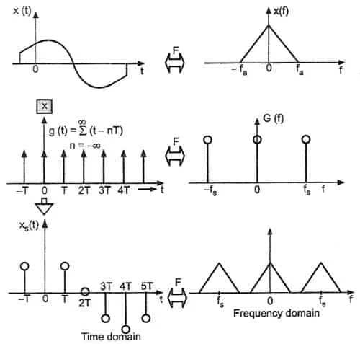
Sampling in DSP:.
sampling process in the time domain
frequency domain equivalents on the right

Slide 56
Review Questions
How is digital signal converted ?
What is Sampling?
What is meant by aliasing ?
When do aliasing occur?
What is Quantization?
Define Sampling rate
What is Anti-alising filter?

Slide 57
References
1. John G. Proakis, Dimitris G. Manolakis, “Digital Signal Processing, Principles, Algorithms and Applications”, Pearson Education, 4th edition, 2014
2. Alan V. Oppenheim, Ronald W. Schafer, “Discrete-Time Signal Processing”, Pearson Education, 1st edition, 2015
3. Sanjit Mitra, “Digital Signal Processing –A Computer Based Approach”, McGraw Hill, India, 4th Edition, 2013.
4. Fredric J. Harris, “Multirate Signal Processing for Communication Systems”,1st edition, Pearson Education, 2007

